Slide 1

What is Artificial Intelligent
The human intelligence inside the computer is called Artificial Intelligence.
What is Machin learning
Making the machines to learn is called Machine Learning.
There are 3 types:
1.Supervised learning
2.Unsupervised learning
3.Reinforcement learning
1.Supervised learning – leaning from Someone.
2.Unsupervised learning – leaning by our own.
3.Reinforcement learning – It involves rewards and penalty.

Slide 2
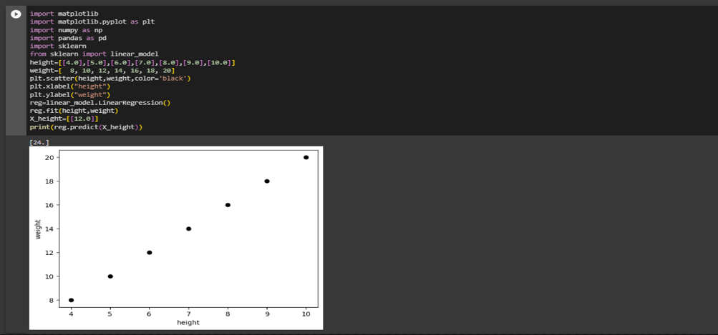
Regression is used for continuous data prediction.
Classification - yes/no , true/false , this/that.
What is linear Regression.
Linear regression is a statistical modeling technique used to establish a relationship between a dependent variable and one or more independent variables.
Code of linear Regression

Slide 3
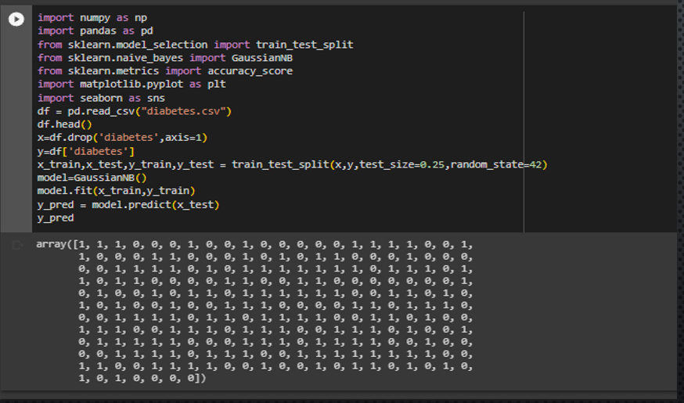
Naive Bays
Naive Bayes is a probabilistic classification algorithm based on Bayes' theorem with an assumption of independence between features.

Slide 4
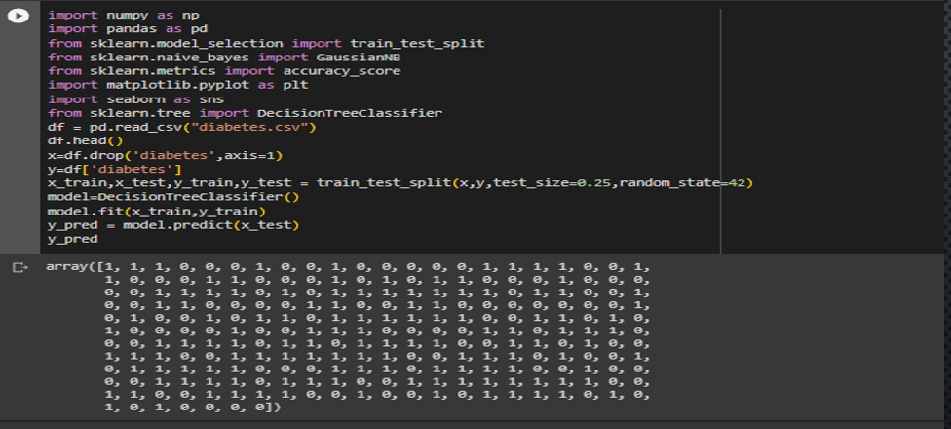
Decision tree - A decision tree is a flowchart-like structure that represents a series of decisions and their potential consequences or outcomes. It is a supervised machine learning algorithm that can be used for both classification and regression tasks.
Code :

Slide 5
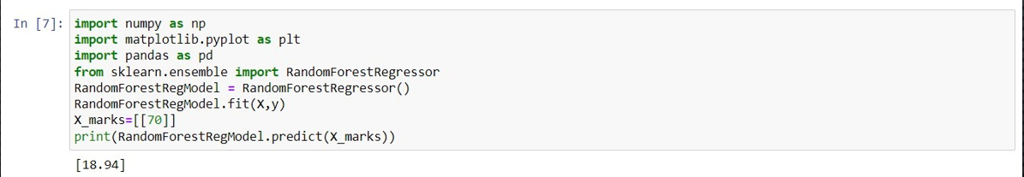
Random Forest - Random Forest is an ensemble machine learning algorithm that combines the predictions of multiple individual decision trees to make more accurate and robust predictions.
Code :

Slide 6
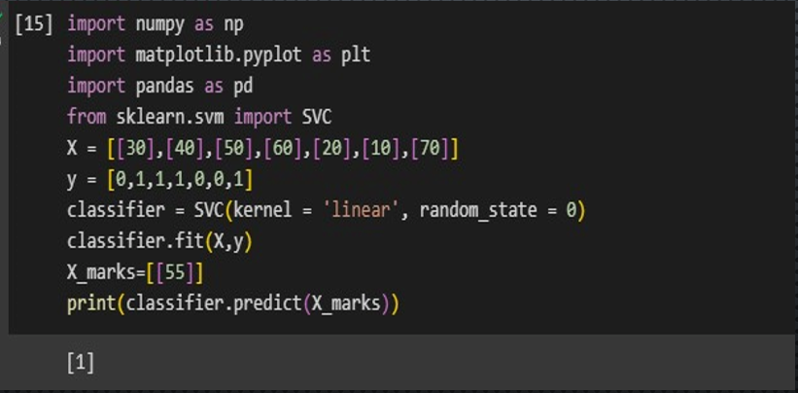
SVM - Support Vector Machines (SVM) is a supervised machine learning algorithm used for both classification and regression tasks. SVMs are particularly effective in solving complex problems with high-dimensional feature spaces.
Code –

Slide 7
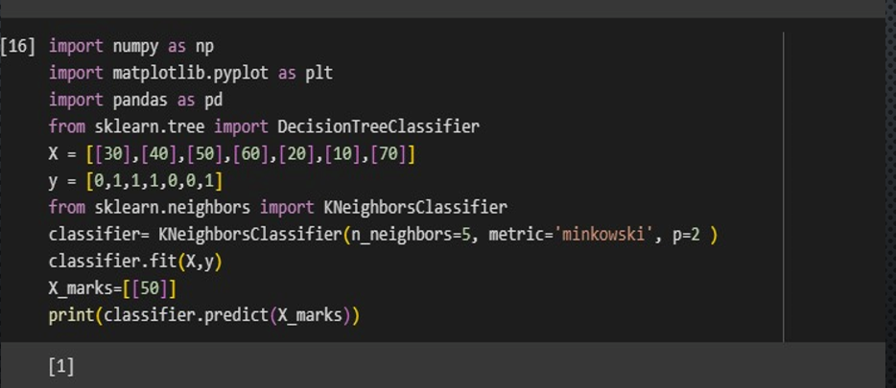
K-Nearest Neighbors (KNN) is a supervised machine learning algorithm used for classification and regression tasks. It is a non-parametric algorithm, meaning it does not make any assumptions about the underlying distribution of the data.
Code –

